Slide 1
FIL251 2019
WEEK 1: Introduction

Slide 2
Rules
Only ONE person speaks at a time.
NO talking to your ‘friend’ or friend unless asked to.
NO recording of the lectures on cellphones or other devices. IT IS ILLEGAL without permission (you do not have such).
Please respect the tutors, myself and our discipline.

Slide 3
Why are you here?
NEVER
“It’s Just Business”
^
ALL situations are constituted by moral dimensions, albeit professional, familial, the lecture hall or in the club.
You are going to work with humans in your prospective profession. We are going to try and bridge the gap between your discipline and the moral effects it may have on humanity (in one capacity or another).
Plus, professors around the world agree that this is a constructive, instructive and necessary experience for all students of the EMS.

Slide 4
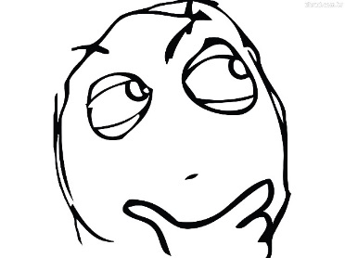
WHAT IS PHILOSOPHY?
Philosophy begins with wonder…
The investigation of fundamental problems
What is real?
How do we know anything?
What is the best way to live?

Slide 5
The Branches of PHILOSOPHY
Metaphysics: What is reality?
Epistemology: What is knowledge?
Ethics: What is the right thing to do?
Aesthetics: What is beauty?
Logic: What is good reasoning?

Slide 6
3 DIMENSIONS OF ETHICAL THINKING
Moral Reflection
Moral Arguments
Moral Agency

Slide 7
Moral reflection
We start with a conviction/intuition about the right thing to do
Then reflect on the principle on which our conviction is based
When confronted with a rebuttal, we may become confused or unsure, and be forced to revise or refine our principle
Moral philosophy is about the drive to sort out that confusion, to figure out what we think about right and wrong and WHY
Often, this will involve formulating moral arguments

Slide 8
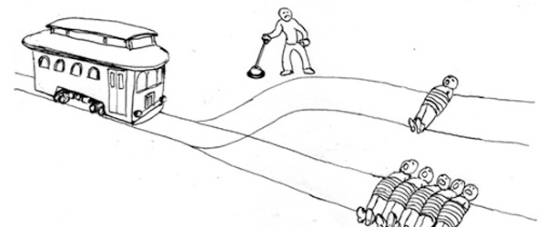
Moral reflection: The Trolley Problem

Slide 9
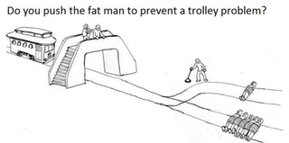
Trolley Problem Variations

Slide 10
FIL 251 Course Structure
Ethical Theories: Content lectures
Case Studies: Discussion Lectures
Critical Thinking Skills: Tutorials

Slide 11
How to pass fil251
BE AWARE
The Study Guide
Plagiarism
Marks on Click Up
PARTICIPATE
Lectures + Tutorial Classes
PREPARE
Class tests
Semester Test
Tutorial Assignments
CONSULT!
Lecturer
Tutor

Slide 12
How to fail fil251
Miss lectures and don’t prepare for them
Miss tutorial classes
Decide your questions don’t matter
Decide to check out
Believe that since you’re doing amazing in your other courses, this one should be a breeze
Best tip: Don’t consider asking for help!

Slide 13
Next Time & Admin
Prescribed Textbook: M. J. Sandel, What’s The Right Thing to Do (2009). + The other texts already uploaded on clickup.
What is Corruption? (NB Study for class test!)
Make friends with our ClickUp page
Register for a tutorial group by the end of the week!
Check out the recommended materials

